Slide 1
CREDIT CARD DEFAULT PREDICTION
PRESENTED BY: MS.AARUSHI JAIN

Slide 2
OUTLINE OF PRESENTATION
Introduction
Objective of Project
Motivation
Literature Survey
Software/hardware requirements
Application Architecture
Proposed Model
Implementation
Result
Conclusion
References

Slide 3
INTRODUCTION
Banks plays a significant role in providing financial services to help people and business to achieve their goals as well as to reach their potential.
When a customer applies for and receive a credit card , it becomes huge responsibility for customer as well as credit card issuing company
To keep integrity Bank must avoid in investing wrong customers who can default and cause loss to the Financial Institution
Credit card default prediction is a crucial task for banks and financial institutions as it helps them assess the risk of lending to potential borrowers.

Slide 4
OBJECTIVE
To help concerned institutions identify customers who are likely to default on their credit card payments, allowing them to take proactive measures to mitigate their risk.
To provide a model that can accurately predict the probability of default which will be more valuable than identifying whether a customer is likely to default on their credit card payments or not

Slide 5
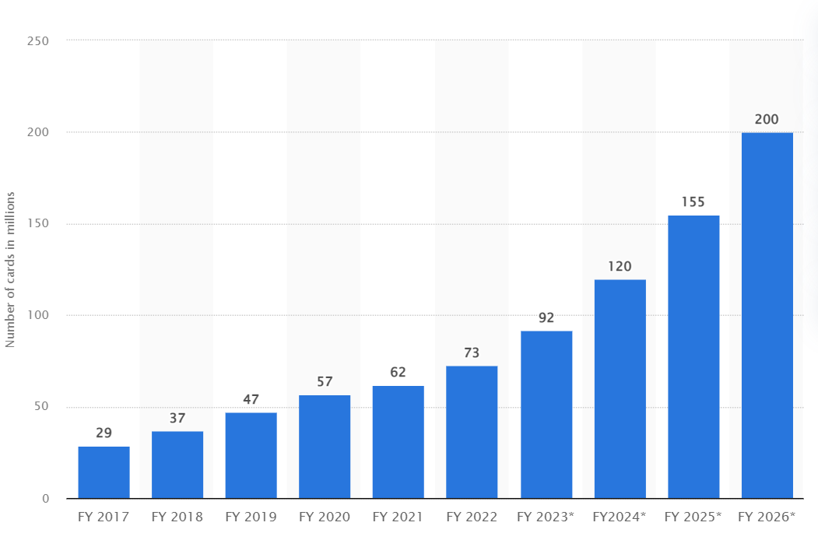
MOTIVATION
Credit card default can have severe consequences for both the lender and the borrower. Developing accurate models to predict default can help mitigate these risks and improve financial stability for individuals and institutions.
This is a real-world problem that affects millions of people every day. Being able to contribute to solutions that have a direct impact on people's lives is highly motivating.

Slide 6
LITERATURE SURVEY
Machine learning algorithms such as logistic regression, decision tree, neural networks, and support vector machines have been widely used for credit card default prediction.
A comparative study of credit card fraud detection techniques can be useful to understand the advantages and disadvantages of various approaches.
Neural network models have also been used for credit card default prediction, and their performance has been evaluated using confusion matrix and ROC curve analysis.
Feature selection is an important step in credit card default prediction, and techniques such as PCA and Lasso regression can be useful to identify important features.

Slide 7
SOFTWARE / HARDWARE REQUIREMENTS
Jupyter notebook/lab
Compatible windows version

Slide 8
APPLICATION ARCHITECTURE
Preprocessing data
Analysing variables
Applying models
Comparing models
Analyse best model
Evaluating models

Slide 9
PROPOSED MODEL
Logistic Regression
It is used for Binary classification
By analyzing the coefficients of the predictor variables in the logistic regression model, we can determine which factors have the most significant impact on the probability of default
Random Forest
It can handle complex and non-linear relationships.
It works by creating an ensemble of decision trees, each of which is trained on a random subset of the data and a random subset of the predictor variables.

Slide 10
EVALUATION PROCESS
Evaluation metrics:
Accuracy: Accuracy determine how often the model predicts default and non-default correctly.
Precision: Precision calculates whenever our models predicts it is default how often it is correct.
Recall : Recall regulate the actual default that the model is actually predict.
F1 Score: F1 score computes how many times a model made correct prediction.

Slide 11
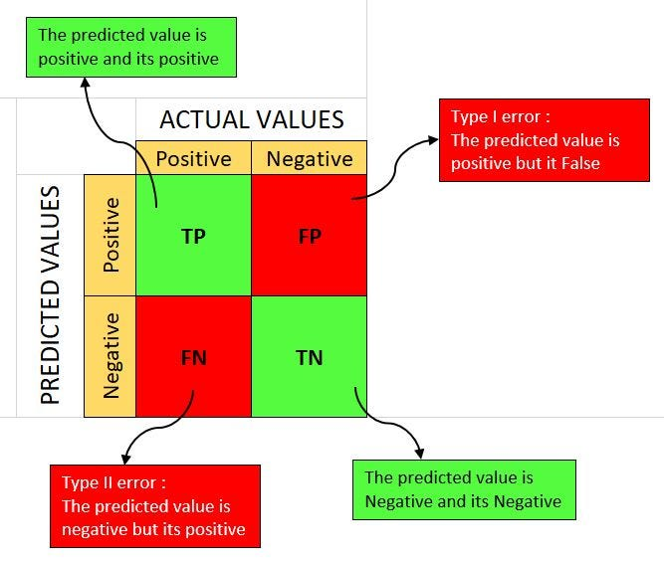
CONFUSION MATRICS
True Positive- A person who is defaulter and predicted as defaulter.
True Negative- A person who is non-defaulter and predicted as non-defaulter.
False Positive- A person who is non-defaulter and predicted as defaulter.
False Negative- A person who is defaulter and predicted as non-defaulter.

Slide 12
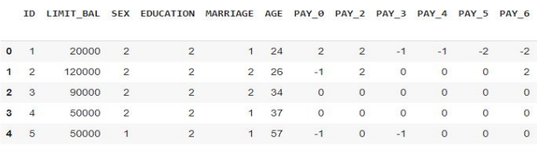
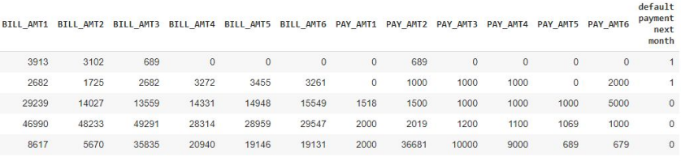
DATA SUMMARY

Slide 13
FEATURE SUMMARY
X1 -Amount of credit(includes individual as well as family credit)
X2 -Gender
X3 -Education
X4 -Marital Status
X5 -Age
X6 to X11 -History of past payments from April to September
X12 to X17 -Amount of bill statement from April to September
X18 to X23 -Amount of previous payment from April to September
Y -Default payment

Slide 14
INSIGHTS OF DATA SET
This Dataset is from Taiwan.
In our data set there are 30000 rows, 26 columns
There are No Missing Values present
There are No Duplicate values present
There are No null values.
And finally we have 'default payment next month' variable which we need to predict for new observations
6 Months payment and bill data available.
The Columns are: - 'ID', 'LIMIT_BAL', 'SEX', 'EDUCATION', 'MARRIAGE', 'AGE', 'PAY_0', 'PAY_2', 'PAY_3', 'PAY_4', 'PAY_5', 'PAY_6', 'BILL_AMT1', 'BILL_AMT2', 'BILL_AMT3', 'BILL_AMT4', 'BILL_AMT5', 'BILL_AMT6', 'PAY_AMT1', 'PAY_AMT2', 'PAY_AMT3', 'PAY_AMT4', 'PAY_AMT5', 'PAY_AMT6', 'defaulters', 'AGE_BIN'

Slide 15
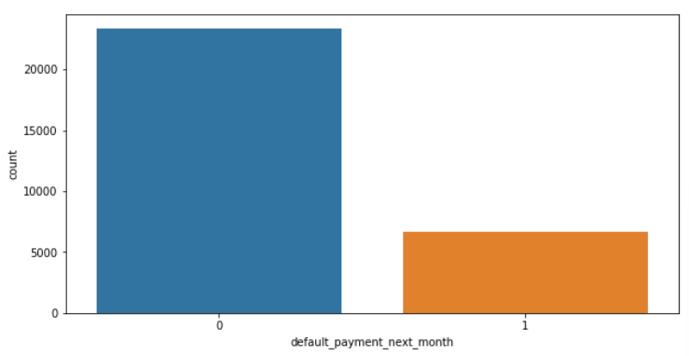
IMPLEMENTATION
ANALYSIS OF DEPENDENT VARIABLE
As we can see from above graph that both classes are not in proportion and we have imbalanced dataset. we need to do normalize the data in next step.
0: 23364
1:6636
0-Not Default
1-Default

Slide 16
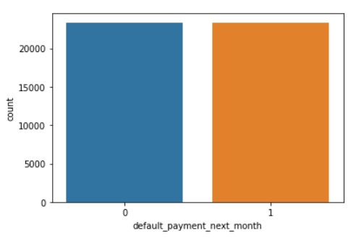
SMOTE
SMOTE (Synthetic Minority Oversampling Technique) – Oversampling is one of the most commonly used oversampling methods to solve the imbalance problem. It aims to balance class distribution by randomly increasing minority class examples by replicating them.
After performing SMOTE operation we get this balance dataset

Slide 17
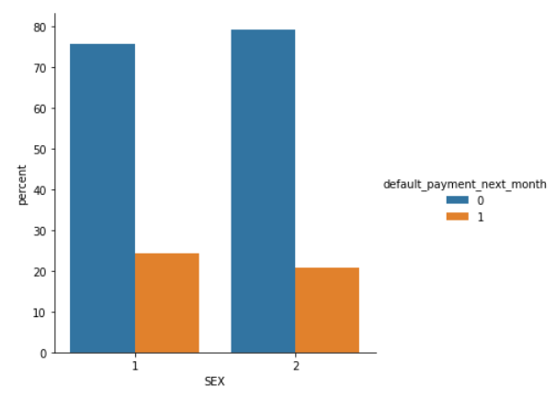
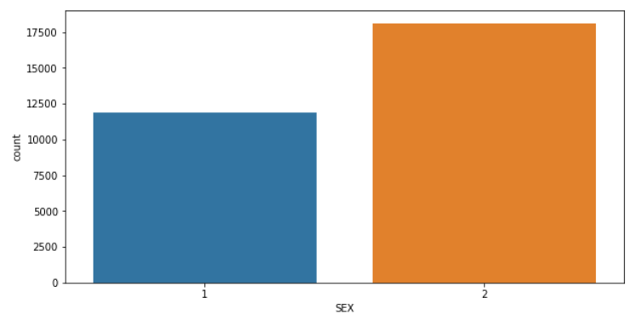
ANALYSIS OF SEX VARIABLE
1 - Male 2 - Female
Number of Male credit holder is less than Female.
It is evident from the above graph that the number of defaulter have high proportion of males

Slide 18
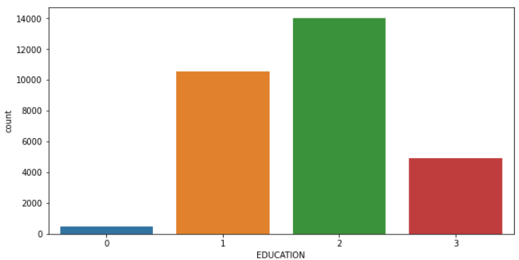
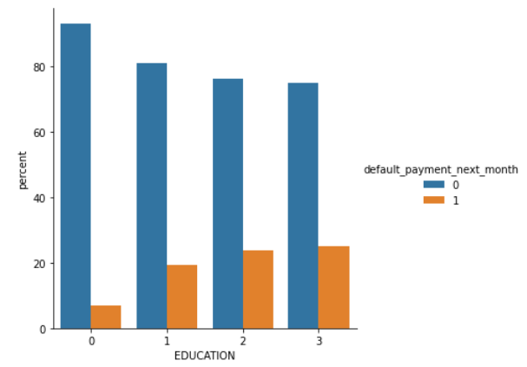
ANALYSIS OF EDUCATION VARIABLE
1=graduate school, 2=university, 3=high school, 0=others
From the above left side plot we can say that :
More number of credit holders are university students followed by Graduates and then High school students.
From the right side plot it is clear that those people who are other students have higher default payment wrt graduates and university people

Slide 19
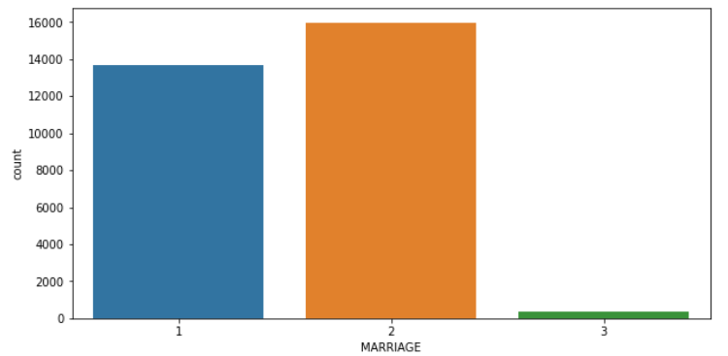
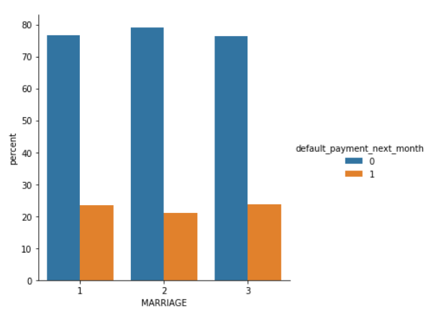
ANALYSIS OF MARRIAGE VARIABLE
1 - married 2 - single 3 - others
From the above data analysis we can say that :
More number of credit cards holder are Single.
High defaulter rate when it comes to others

Slide 20
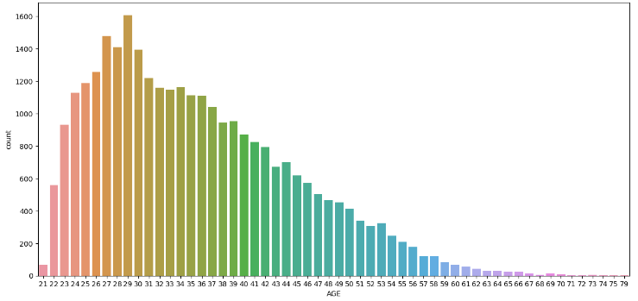
ANALYSIS OF AGE VARIABLE
From the above count plot analysis we can say that:
We can see more number of credit cards holder age are between 26-30 years old.
Age above 60 years old rarely uses the credit card.

Slide 21
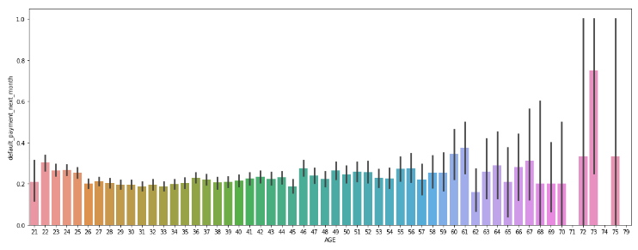
ANALYSIS OF AGE VARIABLE
From the above bar plot which shows the relationship between age and defaulter, we can say that :
Those who default are 60 years and older, that may be they don’t use their card frequently

Slide 22
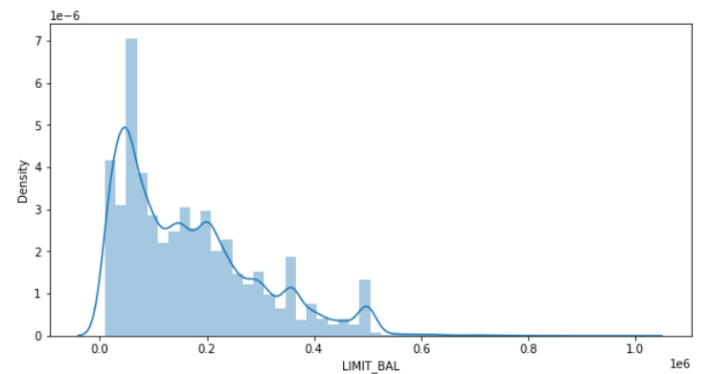
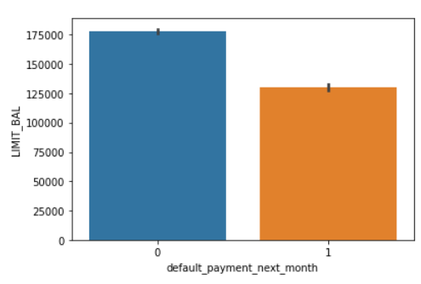
ANALYSIS OF LIMIT BALANCE VARIABLE
From the above plots analysis we can say that :
Maximum amount of given credit in NT dollars is 50,000 followed by 30,000 and 20,000

Slide 23
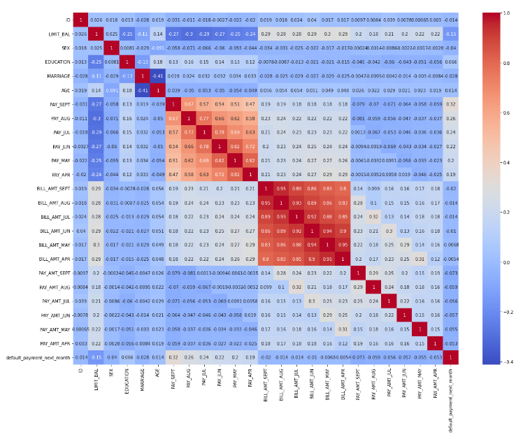
CHECKING OF CORRELATION
From the above graph we can see , that there are some negatively correlated feature like age but we cannot blindly remove this feature because it could be important feature for prediction.
ID is unimportant and it has no role in prediction so we will remove it.

Slide 24
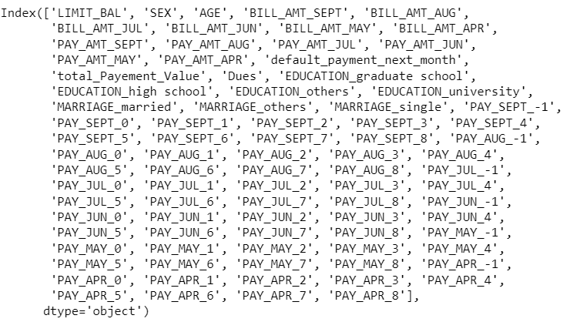
ONE HOT ENCODING
One hot encoding is a process by which categorical variables are converted into a form that could be provided to ML algorithms to do a better job in prediction.
Here we perform one hot encoding on 'EDUCATION','MARRIAGE','PAY_SEPT', 'PAY_AUG', 'PAY_JUL', 'PAY_JUN', 'PAY_MAY', 'PAY_APR' and label encoding for ‘SEX’
After this we get these features in our dataset:

Slide 25
LOGISTIC REGRESSION
PARAMETERS : {'C': 0.01, 'penalty': 'l2’}
from this regression model we get the results as below
The accuracy on test data is 0.7553984825886778
The precision on test data is 0.6936446173800259
The recall on test data is 0.7913583900562297
The f1 on test data is 0.7392867016864806
The roc_score on test data is 0.7593522874903104

Slide 26
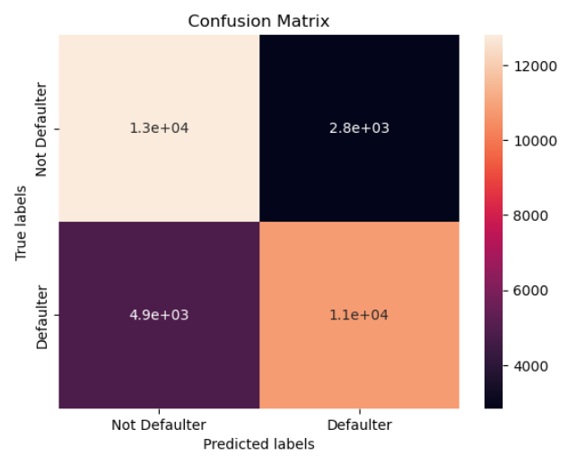
CONFUSION MATRIX
From the matrix we can say that the true positive has the higher rate around 12000 but rate of true negative is little less around 10000

Slide 27
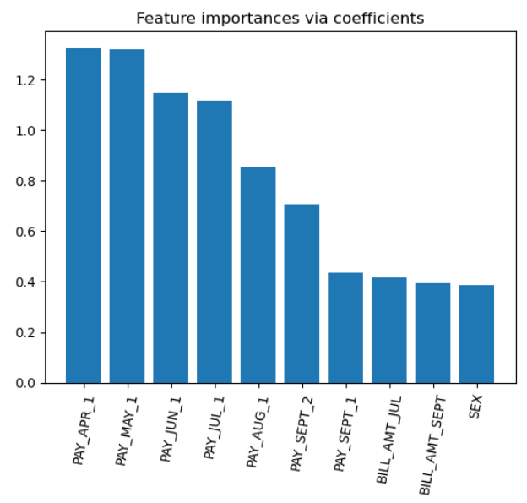
FEATURE IMPORTANCES
From the graph we can say that the most important feature that make an impact on dependent variable are PAY_JUL_1,PAY_MAY_1,PAY_APR_1

Slide 28
RANDOM FOREST
PARAMETERS : {'max_depth': 30, 'n_estimators': 150} from the regression model we get the results as below
The accuracy on test data is 0.8337332209324947
The precision on test data is 0.8020752269779508
The recall on test data is 0.856272500692329
The f1 on test data is 0.8282882400214305
The roc_score on test data is 0.8350761210621055

Slide 29
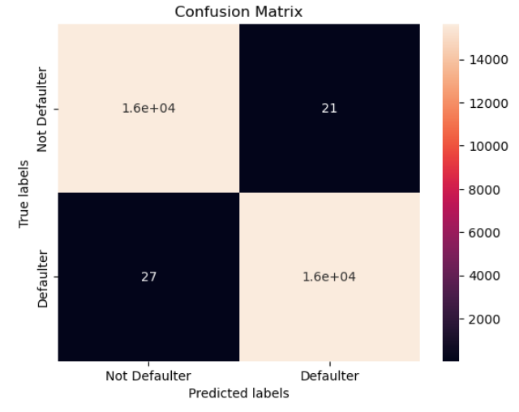
CONFUSION MATRIX
From the matrix we can say that the true positive and true negative have higher rate around 14000

Slide 30
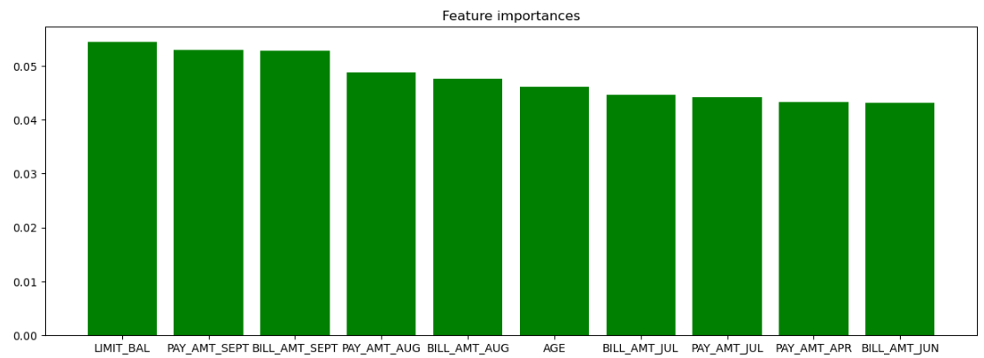
FEATURE IMPORTANCES
From the graph we can say that the most important feature that make an impact on dependent variable are LIMIT_BAL,PAY_AMT_SEPT

Slide 31

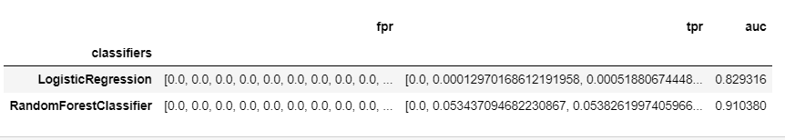
EVALUATING THE MODELS
We can see the performance of Random Forest is better in terms of accuracy, precision, recall and f1 score . Also, it has better auc.

Slide 32
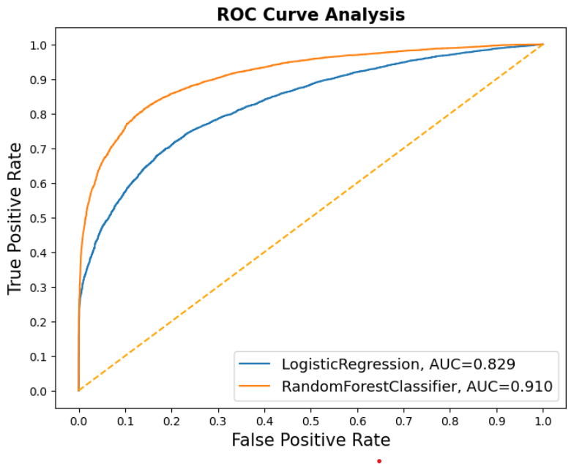
ROC CURVE ANALYSIS
Here, we can see that Logistic Regression ROC curve is more closer to 45-degree diagonal of the ROC space, therefore, it is less accurate in comparison to Random Forest Classifier

Slide 33
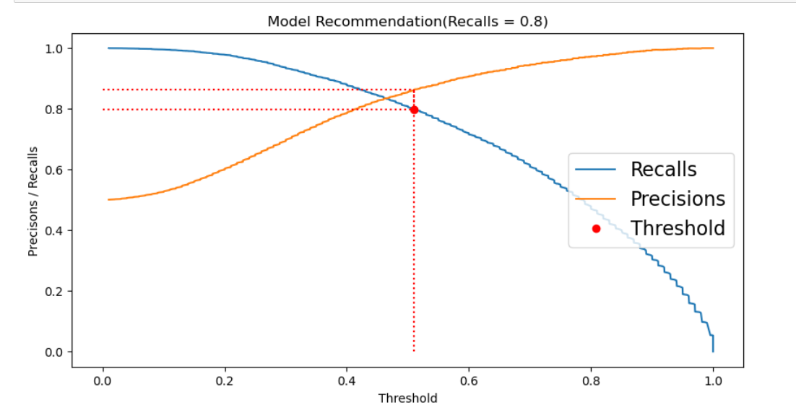
RESULTS
Comparison of implemented algorithm with AUC-ROC Curve

Slide 34
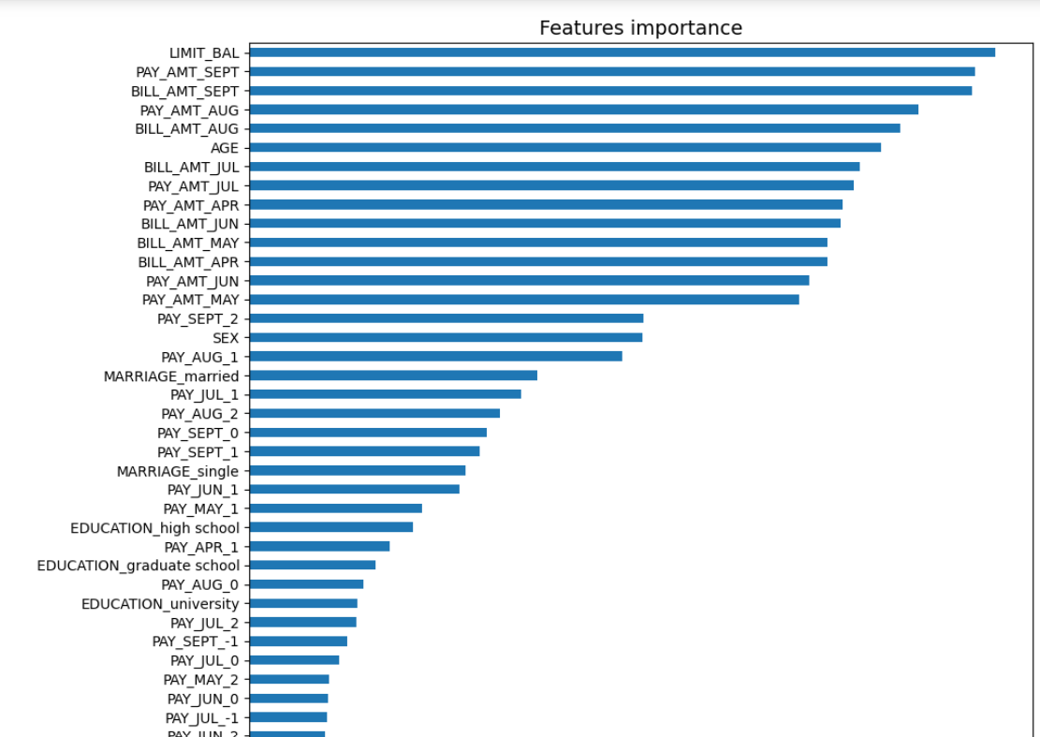

Slide 35
CONCLUSIONS
Recent 2 months payment status and credit limit are the strongest default predictors.
Recall is the best accuracy metrics here, because if the algorithm will not detect the defaulters, that will encounter more loss to the bank
Random Forest has good score but leads to overfit the data.
Logistic regression is less accurate with a recall of 79%.
Higher recall can be achieved if low precision is acceptable.
This Model can only be served as an aid in decision making instead of replacing human decision.
Model can be improved with more data and computational resources.

Slide 36
REFERENCES
https://www.statista.com/statistics/1203267/india-number-of-credit-cards/
https://www.kaggle.com/uciml/default-of-credit-card-clients-dataset/discussion/34608

